Slide 1
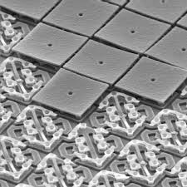
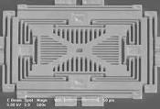
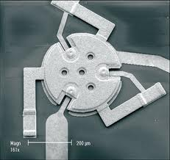
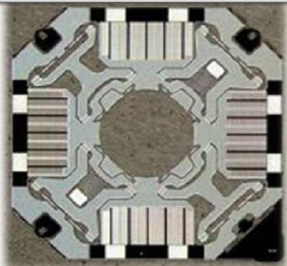
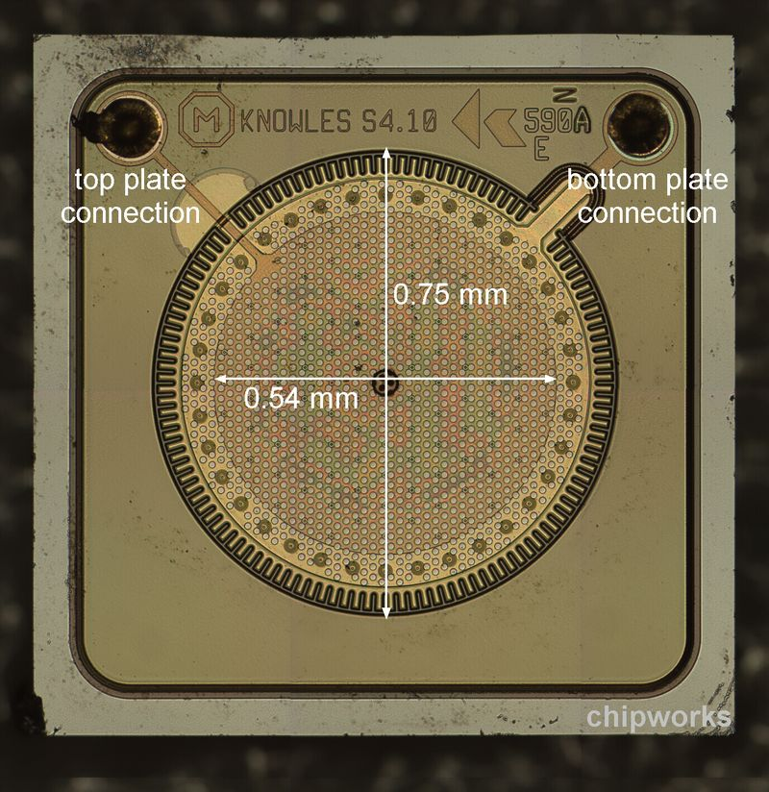
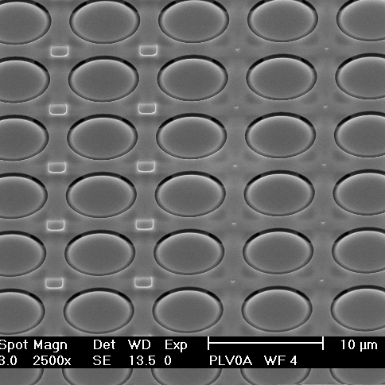
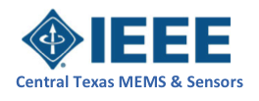
IEEE MEMS & Sensors Council Chapter (SEN39)
ExCom update
Brent Lunceford
Chair, IEEE Central Texas MEMS & Sensors Council Chapter
September 19, 2017

Slide 2
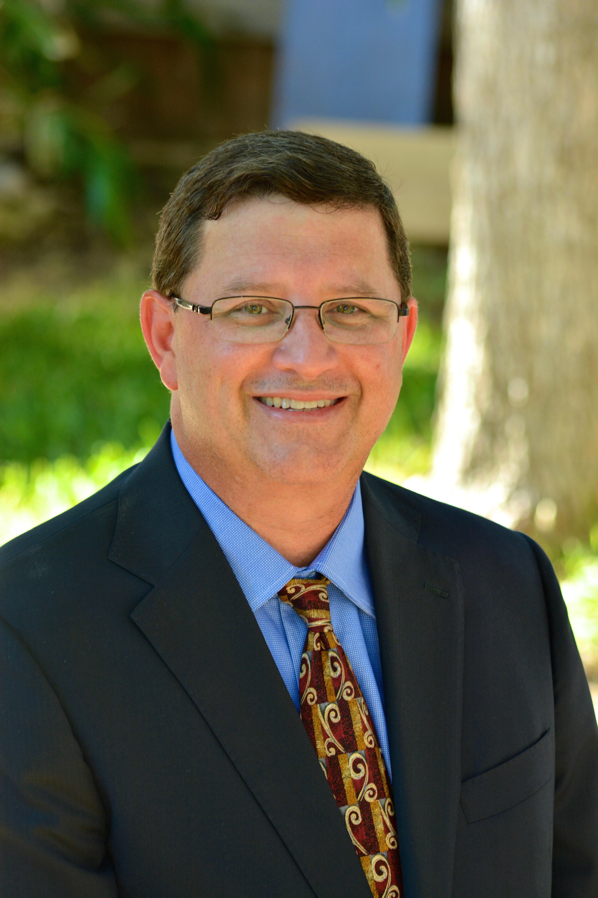
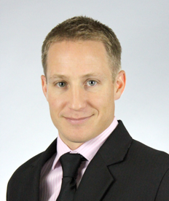
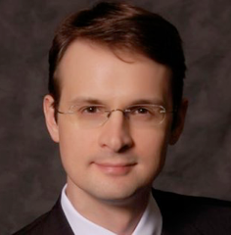
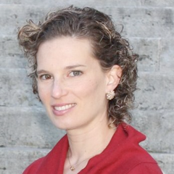
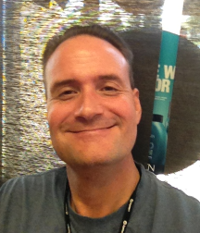
IEEE Central Texas MEMS & Sensors Committee
Founding Committee Members
Brent Lunceford
Brian Mattis
Colin Tompkins
Lia Almeida
Dr. Don Smith

Slide 3
Update of important events
Chapter recognized in July 2017 edition of IEEE Consumer Electronics Magazine (digital & print)
Topic of our first chapter event recently aired on Leno’s Garage TV Show-July 2017

Slide 4
International Recognition of Central Texas Chapter-July 2017 edition

Slide 5
Meeting Summary
Topic | Who | Comments
Driving With Your Head – Arrow Semi-Autonomous Motorcar (SAM) with NXP Technology | Joe Thompson-NXP Semi. | Recently on Leno’s Garage TV show, July 2017
Sensors for Health Monitoring in Wearable Devices | Collin Tompkins – Silicon Labs
Biologically Inspired Microphones | Neal Hall - UT Austin
Human-Robot Interaction and Whole-Body Sensing | Distinguished Lecturer Dr. Vladimir Lumelsky | Joint event with EDS @ UT Commons Learning Center
Next Generation Biometric Sensing in Wearables |  | Sherlocks Baker St. Pub
TexNet – Texas Seismic Sensor System | UT Austin Bureau of Economic Geology | North X Northwet Restaurant-lost $
MEMS in Austin – Days of Disruption, Market Creation, and Industry Growth
3D Integration in Advanced CMOS & Sensors | Brian Mattis | Capital Factory Event

Slide 6
Rest of Year Plans
Month | Meeting Topic-title | Comments
October | Soliciting speaker - targeting Army Research Labs (Ft. Hood), NASA, SwRI, SpaceX, Amazon, AtlasWearables, UnderArmour | Need existing technology case
November | Holiday Social Event at NXNW Restaurant-Stonelake location or Austin Land & Cattle (Lamar, near city center) | Self pay event
December | Holiday break

Slide 7
SWOT Analysis
Increasing strength of community relationships (UT, IEEE, TSU)
Growing regional industry, start ups
Tech. is driving growth in wearables, autonomous vehicle, biomed & health, IoT, IIoT, automation, med device, AR
Tech is a new market creator
City wide meeting competition
Participants have meeting fatigue
Low attendance
Finding a home w/o spending $
Traffic, congestion
Magnetism helps other chapters
Continued regional growth from Silicon Valley relocation/colocations
Talent con’t to move into region
Building on momentum
Magnetism will build other IEEE entities
Other industry groups & political agendas
Lacking industry engagement
Agenda not aligned to industry/academia
Other chapters, Meetups, groups
M&A
Highly competitive and sensitive IP
Strengths
Weakness
Opportunities
Threats

